Slide 1




Consider the following relations on {1, 2, 3, 4}:
R1 = {(1, 1), (1, 2), (2, 1), (2, 2), (3, 4), (4, 1), (4, 4)},
Not reflexive (3,3) does not exist, not symmetric (4,3) does not exist,
Not transitive (4,1)(1,2) but not (4,2), not irreflexive (1,1) exists, not atisyymetric (1,2) and (2,1) exists, obviously not antisymmetric .
R2 = {(1, 1), (1, 2), (2, 1)},
not reflexive, transitive (2,1),(1,2) but (2,2) does not exist,
R3 = {(1, 1), (1, 2), (1, 4), (2, 1), (2, 2), (3, 3), (4, 1), (4, 4)},
R4 = {(2, 1), (3, 1), (3, 2), (4, 1), (4, 2), (4, 3)},
R5 = {(1, 1), (1, 2), (1, 3), (1, 4), (2, 2), (2, 3), (2, 4), (3, 3), (3, 4), (4, 4)},
R6 = {(3, 4)}.
Determine which of these relation are Reflexive, Symmetric, Transitive, Antisymmetric, Irreflexive and Asymmetric.

Slide 2

Combining Relations
As R is a subsets of A x B, the set operations can be applied
Union (U)
Intersection (∩)
Difference (-)
Symmetric Complement (⊕) / Symmetric Difference
Given two relations R₁ and R₂, we can combine them using basic set operations to form new relations such as R₁ 𝖴 R₂, R₁ ∩ R₂, R₁ − R₂, R₂ − R₁ and R₁ ⊕ R₂.

Slide 3

Combining Relations
Given, A = {1,2,3}, B = {1,2,3,4}
R1 = {(1,1),(2,2),(3,3)},
R2 = {(1,1),(1,2),(1,3),(1,4)}
R1 U R2 = {(1,1),(1,2),(1,3),(1,4),(2,2),(3,3)}
R1 ∩ R2 = {(1,1)}
R1 - R2 = {(2,2),(3,3)}
R2 - R1 = {(1,2),(1,3),(1,4)}
R1 ⊕ R2 = {(1,2),(1,3),(1,4),(2,2),(3,3)}

Slide 4

Composition of Relations
Definition: Suppose
R₁ is a relation from a set A to a set B.
R₂ is a relation from B to a set C.
Then the composition (or composite) of R₂ with R₁, is a relation from A to C where
if (x,y) is a member of R₁ and (y,z) is a member of R₂,
then (x,z) is a member of R₂∘ R₁.

Slide 5





Representing the Composition of a Relation
R₁ R₂
w
m
a
x
n
b
y
o
c
p
z
R₁∘ R₂ = {(b,D),(b,B)}

Slide 6

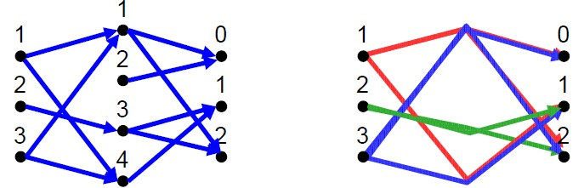
Composition of Relations
What is the composite of the relations R and S, where
R is the relation from {1,2,3} to {1,2,3,4} with R = {(1,1),(1,4),(2,3),(3,1),(3,4)}
S is the relation from {1,2,3,4} to {0,1,2} with S = {(1,0),(1,2),(2,0),(3,1),(3,2),(4,1)}?
S o R = {(1,0),(1,2),(1,1), (2,2),((2,1), 3,0),(3,2),(3,1)}

Slide 7

INVERSE OF A RELATION
Let R be a relation from A to B. The inverse relation
𝑅⁻¹ from B to A is defined as:
𝑅⁻¹ = {(b,a) ∈B×A | (a,b) ∈R}
More simply, the inverse relation 𝑅⁻¹ of R is obtained by interchanging the elements of all the ordered pairs in R.
Example
X = {a, b, c} and Y={1, 2}
R = {(a, 1), (b, 2), (c, 1)}
𝑅⁻¹ = {(1, a), (2, b), (1, c)}

Slide 8

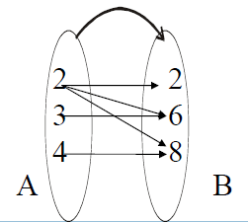
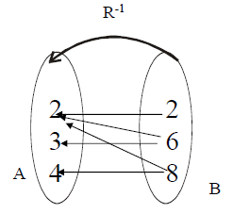
INVERSE OF A RELATION
The relation
R = {(2,2), (2,6), (2,8), (3,6), (4,8)} is
represented by the arrow diagram.
Then inverse of the above relation can be obtained simply changing the directions of the arrows and hence the diagram is

Slide 9




Slide 10

Equivalence Relations
Definition 1: A relation on a set A is called an equivalence relation if it is reflexive, symmetric, and transitive.
Definition 2: Two elements a, and b that are related by an equivalence relation are called equivalent. The notation a ∼ b is often used to denote that a and b are equivalent elements with respect to a particular equivalence relation.

Slide 11

Strings
Example:
Suppose that R is the relation on the set of strings of English letters such that aRb if and only if l(a) = l(b), where l(x) is the length of the string x. Is R an equivalence relation?
Solution: Show that all of the properties of an equivalence relation hold.
Reflexivity: Because l(a) = l(a), it follows that aRa for all
strings a.
Symmetry: Suppose that aRb. Since l(a) = l(b), l(b) = l(a) also holds and bRa.
Transitivity: Suppose that aRb and bRc. Since l(a) = l(b),
and l(b) = l(c), l(a) = l(a) also holds and aRc.

Slide 12

Congruence Modulo m
Example: Let m be an integer with m > 1. Show that the relation
R = {(a,b) | a ≡ b (mod m)}
is an equivalence relation on the set of integers.
Solution: Recall that a ≡ b (mod m) if and only if m divides a − b.
Reflexivity: a ≡ a (mod m) since a − a = 0 is divisible by m since
0 = 0 ∙ m.
Symmetry: Suppose that a ≡ b (mod m). Then a − b is divisible by m, and so a − b = km, where k is an integer. It follows that b − a = (− k) m, so b ≡ a (mod m).
Transitivity: Suppose that a ≡ b (mod m) and b ≡ c (mod m). Then m divides both a − b and b − c. Hence, there are integers k and l with a − b = km and b − c = lm. We obtain by adding the equations:
a − c = (a − b) + (b − c) = km + lm = (k + l) m.
Therefore, a ≡ c (mod m).

Slide 13
Divides
Example: Show that the “divides” relation on the set of
positive integers is not an equivalence relation.
Solution: The properties of reflexivity, and transitivity do hold, but there relation is not transitive. Hence, “divides” is not an equivalence relation.
Reflexivity: a ∣ a for all a.
Not Symmetric: For example, 2 ∣ 4, but 4 ∤ 2. Hence, the relation is not symmetric.
Transitivity: Suppose that a divides b and b divides c. Then there are positive integers k and l such that b = ak and c = bl. Hence, c = a(kl), so a divides c. Therefore, the relation is transitive.

Slide 14


Slide 15

Partial Orderings
Definition 1: A relation R on a set S is called a partial ordering, or partial order, if it is reflexive, antisymmetric, and transitive.
A set together with a partial ordering R is called a partially ordered set, or poset, and is denoted by (S, R). Members of S are called elements of the poset.

Slide 16

Partial Orderings (continued)
Example 1: Show that the “greater than or equal” relation (≥) is a partial ordering on the set of integers.
Reflexivity: a ≥ a for every integer a.
Antisymmetry: If a ≥ b and b ≥ a , then a = b.
Transitivity: If a ≥ b and b ≥ c , then a ≥ c.
These properties all follow from the order axioms for the integers. (See Appendix 1).

Slide 17

Partial Orderings (continued)
Example 2: Show that the divisibility relation (∣) is a partial ordering on the set of integers.
Reflexivity: a ∣ a for all integers a. (see Example 9 in
Section 9.1)
Antisymmetry: If a and b are positive integers with a | b
and b | a, then a = b. (see Example 12 in Section 9.1)
Transitivity: Suppose that a divides b and b divides c. Then there are positive integers k and l such that b = ak and c = bl. Hence, c = a(kl), so a divides c. Therefore, the relation is transitive.
(Z⁺, ∣) is a poset.

Slide 18

Partial Orderings (continued)
Example 3: Show that the inclusion relation (⊆) is a partial ordering on the power set of a set S.
Reflexivity: A ⊆ A whenever A is a subset of S.
Antisymmetry: If A and B are positive integers with
A ⊆ B and B ⊆ A, then A = B.
Transitivity: If A ⊆ B and B ⊆ C, then A ⊆ C.
The properties all follow from the definition of set inclusion.

